Slide 1
Deploying Web Applications

Slide 2

Web applications are packaged into WAR files
Overview
WAR files have a specific directory structure
Use the Java jar utility to create WARs Hot deploy WAR files into Tomcat

Slide 3





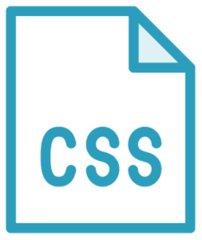


Web Application
WAR
Servlet
Filter
HTML
JSP
Listener
Servlet
JSP
Filter
PNG
Listener

Slide 4
Package and Deploy a WAR

Slide 5
Web applications are packaged in WARs
WAR file structure
META-INF
WEB-INF
classes
packages
JSP, HTML, images, JS, and CSS
Java jar utility creates WAR packages Hot deploy WAR file in Tomcat
Summary

